Slide 1
Comparative Effectiveness of Hospital Outcomes in Medicare Inpatient Elective Laparoscopic Cholecystectomy (ELC)
Susan Nedza, MD, MBA, FACEP
Data source: Medicare Limited Data Set (2010-2012)
Objective: Define differences in performance of inpatient Elective Laparoscopic Cholecystectomy (ELC) in Medicare patients and the opportunity for care improvement.
Methods: Logistic prediction models were developed for Inpatient Deaths, 3-sigma Prolonged Length-of-Stay outliers (prLOS) among live discharges, 90-Day Post-Discharge Readmissions (with scheduled, trauma, and cancer readmissions excluded), and 90-Day Post-discharge Deaths without Readmission (PD-Deaths). Risk-adjusted adverse outcomes (AOs) from the logistic models were computed for hospitals with >50 qualifying cases and Z-scores were calculated for comparison of performance.
Results: 22 hospitals had AOs that were 2 standard deviations less than predicted, and 35 were 2 standard deviations greater than predicted. The risk-adjusted AO rate was 10.5% for the aggregated top quartile of hospitals and was 35.3% for the bottom quartile of performers (P<0.001).

Slide 2
Comparative Effectiveness of Hospital Outcomes in Medicare Inpatient Elective Laparoscopic Cholecystectomy (ELC) Appendix I. Results
Results for 635 Hospitals; 51,311 Patients *
Inpatient Deaths | 281 (0.55%)
RApoLOS Outliers | 3,879 (7.6%)
Post-discharge Deaths without Readmission | 694 (1.4%)
90-Day Post-Discharge Readmissions | 7,372 (13.8%)
Post-discharge Deaths with Readmission | 513 (1.0%)
Overall Adverse Outcomes | 10,803 (21.1%)
Overall 90-Day Death Rate | 2,403 (2.9%)

Slide 3
Comparative Effectiveness of Hospital Outcomes in Medicare Inpatient Elective Laparoscopic Cholecystectomy (ELC) Appendix. MS-DRGs of 90-Day Readmissions
MS-DRGs | Description of Grouping | % of Readmissions
391-395 | Gastrointestinal and Digestive Disease Diagnoses and Disorders | 10.3%
291-293 | Heart Failure and Shock | 5.4%
003-004; 166-168;186-192; 196-208 | Non-infection Pulmonary Diagnosis | 5.3%
870-872 | Septicemia or Severe Sepsis | 4.9%
177-179; 193-195 | Pneumonia or Respiratory Infection | 4.3%
853-858; 862-864 | Postoperative Infections | 4.1%
438-440 | Disorders of the Pancreas; not Malignancy | 3.6%
242-244; 308-310 | Cardiac Arrhythmias and Conduction Disorders | 3.3%
444-446 | Disorders of the Biliary Tract | 3.1%
689-690 | Kidney and Urinary Tract Infections | 2.9%
640-641 | Disorders of Nutrition, Metabolism, and Fluids | 2.8%
371-373 | Major GI Disorders and Peritonitis | 2.7%
377-379 | GI Hemorrhage | 2.6%
682-684 | Renal Failure | 2.6%
231-236; 246-251; 280-285 | Myocardial Infarction, Coronary Artery Intervention | 2.4%
034-039; 061-069 | Cerebrovascular Accident and Ischemia | 2.4%
311-313 | Cardiovascular Symptoms | 2.0%
919-921 | Complications of Treatment | 1.3%
388-390 | GI Obstruction | 1.3%
176-177 | Pulmonary Embolism | 1.2%

Slide 4
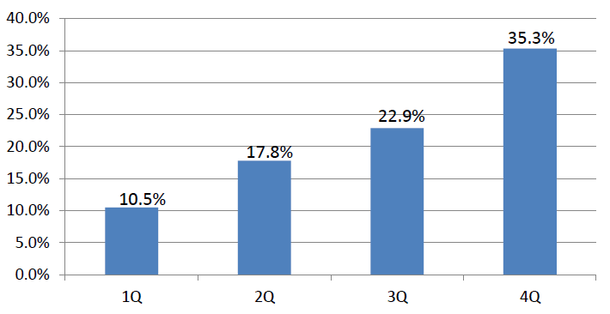
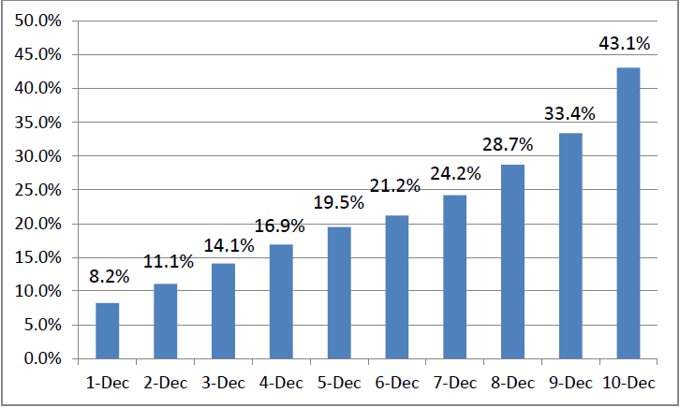
Comparative Effectiveness of Hospital Outcomes in Medicare Inpatient Elective Laparoscopic Cholecystectomy (ELC) Appendix III. Hospital Risk-Adjusted Adverse Outcomes
Hospital Risk-Adjusted AO by Quartile
Hospital Risk-Adjusted AO by Decile

Slide 5
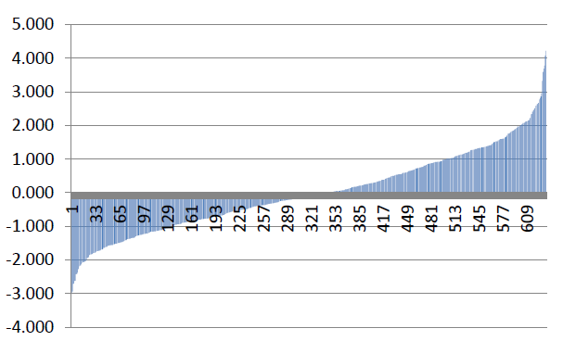
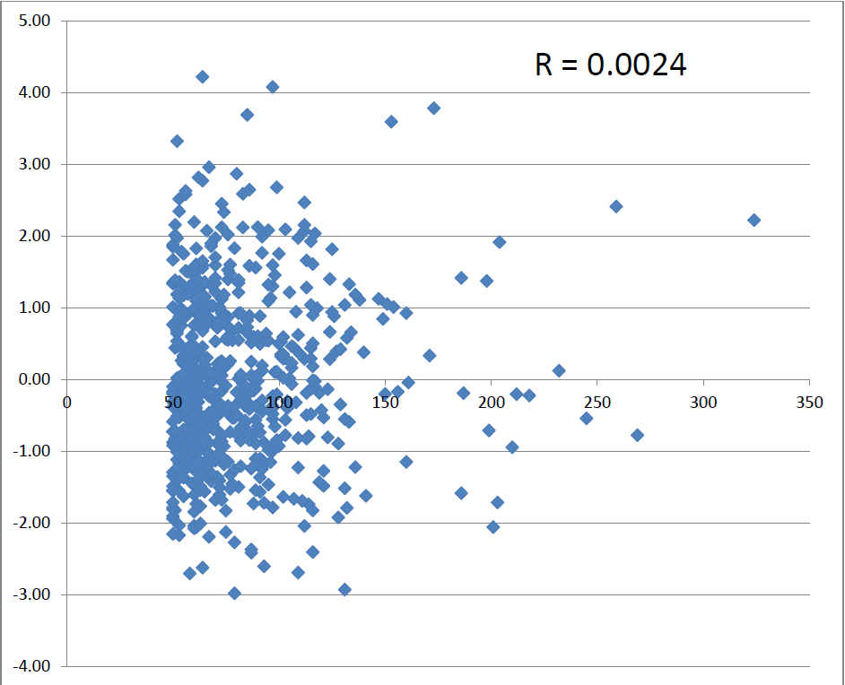
Comparative Effectiveness of Hospital Outcomes in Medicare Inpatient Elective Laparoscopic Cholecystectomy (ELC) Appendix IV. Z-scores for 635 Hospitals
Z-scores
Hospital Case Volume vs. Z-score

