Slide 1
ICD-10 Implementation: Opportunities and Challenges Diane Stollenwerk, MPP NAHDO Conference - October 28, 2015
Input Your Data. Output Your Website.

Slide 2
What I’ll Cover
Quick Overview: What is MONAHRQ® ?
ICD-10 Implications
For Private and Public Reporting
For MONAHRQ in Particular
For Communication with Stakeholders

Slide 3
What is MONAHRQ?
Windows-based software to create your own healthcare quality reporting website for public or private reporting
MONAHRQ is:
Evidence-based (measures, report formats, text, etc.)
Quick and Easy to Use
Flexible and FREE
To access the software and learn more: monahrq.ahrq.gov

Slide 4
Current Use of MONAHRQ
Public reporting in at least fifteen states (see above)
Private reporting by associations and others in several more

Slide 5
MONAHRQ Data Sources
Many sources can be used with MONAHRQ, such as:
Your own Inpatient Hospital Discharge data
Your own hospital Emergency Department (ED) data
AHRQ Quality Indicator™ (AHRQ QI) results
Medicare Provider Inpatient Charge Data
CMS data sets:
Hospital Compare data
Nursing Home Compare data
Physician Compare
Other data using the Open Source Framework

Slide 6
MONAHRQ Report Examples
HOSPITALS
Timely and effective care (e.g. heart care, ED efficiency, maternity)
Patient safety indicators (e.g., HAIs, surgical complications)
Inpatient quality indicators (hospital and area level utilization rates, volume of procedures)
Prevention quality indicators (Admissions rates for ambulatory sensitive conditions)
Patient experience
Pediatric care
Medicare spending
Readmissions and Mortality
NURSING HOMES
Quality of care
Staffing
Health inspections
PHYSICIAN / CLINICIAN PROFILES
PLUS …
Hospital Utilization Trending
Facility Profiles
Guided Education for Consumers About How to Use the Reports
Infographic on Safe Surgery

Slide 7
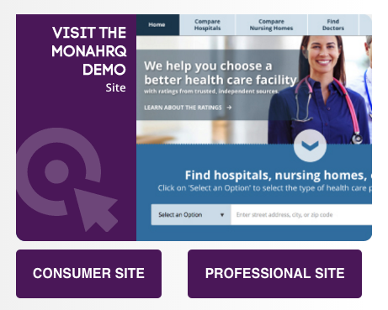
Go to: http://www.ahrq.gov/professionals/systems/monahrq/sites

Slide 8
Fun Facts About ICD Codes
What year was the first ICD code established? (ICD-1)
What year were ICD-9 codes required?
When was the last time a major update was made to medical coding?

Slide 9
ICD-10 Implications: Reporting
All reporting is driven by the underlying data set(s)
ICD-10 data requires revision of measures, which must be addressed carefully
Trust in reports depends on the level of confidence in the underlying data
Transitioning to ICD-10 is a significant change affecting all health care – this require time, patience and refinement
All types of stakeholders want measures that make reports more meaningful to meet their own needs
Over the long run, ICD-10 opens the door for new, more useful measures that are more specific and precise

Slide 10
ICD-10 Implications: MONARHQ
Limited impact on MONAHRQ and websites it generates, although all of the data sources are affected by ICD-10
1. Data sources from CMS: no impact
Host Users will continue to input measure results provided by CMS
2. Raw data used to calculate AHRQ QIs: small impact
Continue to use WinQI or QI SAS software (free from AHRQ) to calculate AHRQ QI results to input into MONAHRQ
QI SAS and WinQI software, to be released in spring 2016, will be able to calculate AHRQ QI results using ICD-10 data
ICD-10 codes will affect the AHRQ QI rates, thus changing the benchmark data and hospitals’ own AHRQ QI results

Slide 11
ICD-10 Implications: MONAHRQ, continued
3. Raw data used for utilization reporting: small impact
Computed within MONAHRQ using the hospital inpatient and ED treat-and-release datasets
Utilization data are grouped using Clinical Classifications Software (CCS) and MS-DRG codes
Where MS-DRG and CCS coding based on ICD-9 is different from ICD-10, it will affect trending reports generated by MONAHRQ
In some cases, it may not be advisable to generate trend reports during the ICD-10 transition
MONAHRQ will be updated in spring 2016 to address these ICD-10 conversion issues

Slide 12
ICD-10 Implications: MONAHRQ, continued
4. Data sets formatted with the Open Source Framework: impact varies
Can continue to input unique datasets and design new reports, but it will be up to the Host User to address any ICD-10 issues
After spring 2016, the Open Source community will have more options to use unique datasets and reports using MONAHRQ
Future: MONAHRQ will continue to evolve and add new measures as available and appropriate

Slide 13
ICD-10 Implications: Communications
Providers and payers:
Extremely aware of risks and challenges associated with ICD-10
Heightened sensitivity and skepticism about validity of results
Employers and other purchasers (and policy makers):
Some may be unaware
Important that they understand risks during the ICD-10 transition if they are using measure results (e.g., value-based purchasing)
Consumers:
Some or most are unaware of ICD-10 and that is fine, unless there are impacts on public reports that need to be explained
Short term cost will yield benefit over the longer term

Slide 14
ICD-10 Implications: Communications, continued
… and it’s not easy. But in the long run, this transition to ICD-10 is important and long overdue.
“Some habits of ineffectiveness are rooted in our social conditioning toward quick-fix, short-term thinking.”
– Stephen Covey

Slide 15
MONAHRQ
For more information, go to monahrq.ahrq.gov
For technical assistance, email MONAHRQ@AHRQ.gov
Thank you!
Diane Stollenwerk, MPP
diane@stollenwerks.com

