Slide 1

Using Claims and Patient Experience Data to Improve Care
A Preliminary View of the Iowa Medicaid Experience
Herb Fillmore, Sr. Dir. Strategic Innovation
Analytics appreciation to Laura Soloway, PhD.
NAHDO 30th Anniversary Conference
@HFillmoreiii

Slide 2
Iowa Medicaid goals for value based population health:
Goal
Improved quality and access
Goal
Greater accountability for outcomes
Goal
More predictable and sustainable Medicaid budget

Slide 3
Improved Quality Outcomes
How’s Your Health Surveys
Member Benefits
Members receive health screening and services tailored to individual needs
Individuals with special health care needs will have comprehensive health risk assessment
Care coordination must be person-centered and address unique needs
MCOs can provide enhanced services not available through a fee-for-service model

Slide 4
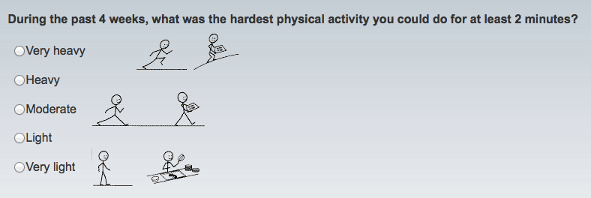
IME AssessMyHealth Survey
Health risk assessment including:
  Patient experience of care
  Patient confidence level (a.k.a. patient activation, engagement)
  Multiple other factors that determine outcomes
Adult IME respondents in 2014 (non-duals): 21,257
  Adult members of Iowa Medicaid
  Solicited via letters & public health announcements as well as provider pitch – premium waiver for completing the assessment + having a wellness visit with PCP

Slide 5
The analyzed sample
Final sample for analysis
Included Responses: | n =20,518
Q2 2014 | 3,336
Q3 2014 | 6,499
Q4 2014 | 10,683
% Female | 59.6%
Race
White | 85.1%
Black or African-American | 7.5%
Other | 7.5%
Age group
18-34 | 26.5%
35-49 | 29.5%
50-64
Survey linked to claims, id=id
  Match rate=98.9% (21,028)
Exclusions/inclusions
  Only ages 18 – 64
  Mismatches with age and sex
    510 taken out for mismatch with age and/or sex
    Brings match rate to 96.5%
Limitations
  Recall bias for utilization in the past year
Data Source: IME claims CY 2014, AMH survey data from IME

Slide 6
Study Questions:
Are patient experience questions about confidence in managing own care, access to care, knowing who the primary care provider is, and receiving the right care, associated with a claims based measure of continuity of care?
Do these experience measures provide additional information about utilization of care beyond claims based continuity measures?

Slide 7
Questions in the experience survey that were tested for association with claims based continuity measure.
1. (A Personal Care Provider) “Do you have one person you think of as your personal doctor or nurse? Yes, No”
2. (Access) “How easy is it for you to get medical care when you need it?
3. (Right service, right time) “When you think about your health care, how much do you agree or disagree with this statement: I receive exactly what I want and need, exactly when and how I want and need it.
4. (Confidence) “How confident are you that you can control and manage most of your health problems?

Slide 8

Claims based continuity of care (COC)calculations. COC varies from 0 to 1, higher =better
Jake has 8 visits with 4 Doctors
Dr. A.
Dr. B.
Dr. C.
Jake’s COC score:
.250
(4² + 2² + 1² + 1²) – 8
8(8 - 1)
= 0.250
Dr. D.
Appreciation and credit to David Nyweide, Ph.D. who created the template for these three calculation examples

Slide 9
Jake has 8 visits with 3 Doctors
Dr. A.
Dr. B.
Dr. C.
Jake’s COC score:
.321
(4² + 3² + 1²) –8
8(8 - 1)
= 0.321
Appreciation and credit to David Nyweide, Ph.D. who created the template for these three calculation examples

Slide 10
Jake has 8 visits with 2 Doctors
Dr. A.
Dr. C.
Jake’s COC score:
.571
(6² + 2²) – 8
8(8 - 1)
= 0.571
Appreciation and credit to David Nyweide, Ph.D. who created the template for these three calculation examples

Slide 12
For those not aware of specialists involved in their care: N=2,702; average age=47 years old
Persons with One or Two Major Chronic Conditions
 | Continuity (COC) | Confident can Manage Dx? | Has a Recognized Primary Care Provider? | Good Access to Primary Care? | Right Service at Right Time?
Readmissions | Sig (↑COC=↓PPR) | Ns | Ns | Ns | Ns
ER visits | Sig (↑COC=↓PPV) | Sig (↑confid=↓PPV) | Sig (Recog=↓PPV) | Sig (↑Access=↓PPV) | Sig(Rightcare=↓PPV)
Total Cost of Care | Sig (↑COC=↓TCC) | Sig (↑confid=↓TCC) | Sig (Recog=↑TCC) | Ns | Ns
For those aware of specialists involved in their care: N=1,872; Average Age=49 years old
 | Continuity (COC) | Confident can Manage Dx? | Has a Recognized Primary Care Provider? | Good Access to Primary Care? | Right Service at Right Time?
Readmissions | Ns | Ns | Ns | Ns | Ns
ER visits | Sig (↑COC=↓PPV) | Sig (↑confid=↓PPV) | Ns | Sig (↑Access=↓PPV) | Sig (Rightcare=↓PPV)
Total Cost of Care | Sig (↑COC=↓TCC) | Ns | Ns | Ns | Ns
Readmissions are measured by 3M Potentially Preventable Readmissions (PPR)
ER visits are measured by 3M Potentially Preventable Visits (PPV)
Total Cost of Care (TCC) includes all Medicaid costs
Sig= T significant at <.05; Ns= non significant
Source: Iowa Medicaid Claims and Patient Experience Surveys, 2014. Reported by permission from Iowa Medicaid Enterprise

Slide 13
For Persons with Three or More Chronic Conditions, Major Malignancies, or Catastrophic Conditions
For those not aware of specialists involved in their care: N=160; Average Age=53 years old
 | Continuity (COC) | Confidence can Manage Dx? | Has A Recognized Primary Care Provider ? | Access to Primary Care? | Right Service at Right Time?
ER visits | Sig (↑COC=↓PPV) | Sig (↑confid=↓PPV) | Ns | Ns | Ns
For those aware of specialists involved in their care: N=275; average age=54years old
 | Continuity (COC) | Confidence can Manage Dx? | Has A Recognized Primary Care Provider ? | Access to Primary Care? | Right Service at Right Time?
ER visits | Sig (↑COC=↓PPV) | Ns | Ns | Ns | Ns
ER visits are measured by 3M Potentially Preventable Visits (PPV)
Sig= T significant at <.05; Ns= non significant
Source: Iowa Medicaid Claims and Patient Experience Surveys, 2014. Reported by permission from Iowa Medicaid Enterprise

